Slide 1
Git for .net Developers
Pete Shearer
Pittsburgh Code Camp 2011.1

Slide 2
Overview of This Talk
What is Git?
What is DVCS? What’s the Difference?
How does it compare?
How to Get Started
Git Commands Explained
Git is Magical !!!
GitHub / AppHarbor
Resources
Q + A

Slide 3
#PGHCC 2011.1 Sponsors
Platinum Sponsors
Gold Sponsors
Silver Sponsors

Slide 4
#PGHCC 2011.1 Sponsors (cont)
Prize Sponsors
Swag Sponsors

Slide 5
Who Am I?
The boring:
Pete Shearer
@PeteOnSoftware
PeteOnSoftware.com
Enterprise Architect at Modern Medical
Huge Nerd
Obsessed With Ninjas

Slide 6
Who Am I?
Programming Stuff That I Dig:
C#
ASP.Net MVC
Ruby On Rails
jQuery
Sql Server (Devs should really know the DB)
Security (especially cryptography)
node.js
WP7
And of course… GIT!

Slide 7
Who Am I?
The important:
HUGE Pittsburgh Sports Fan!

Slide 8
What is Git?
DVCS
What is the difference?
History
What is DVCS?
Why Git?

Slide 9
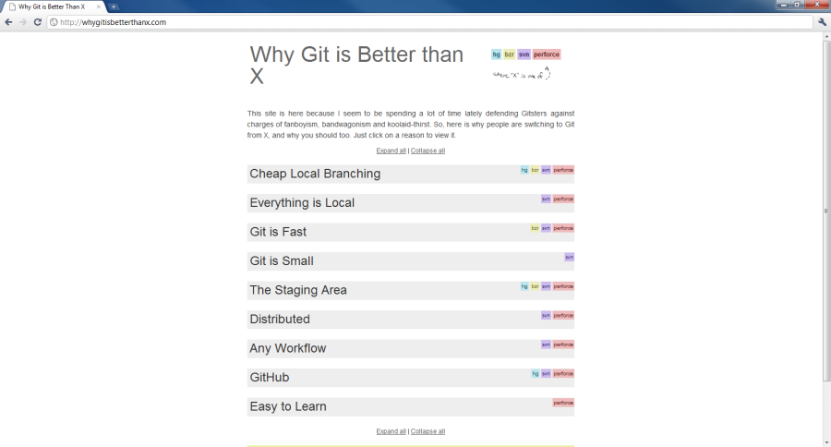
Why Git?
http://whygitisbetterthanx.com

Slide 10
!important
SET YOUR HOME VARIABLE!!!!

Slide 11
Demo

Slide 12
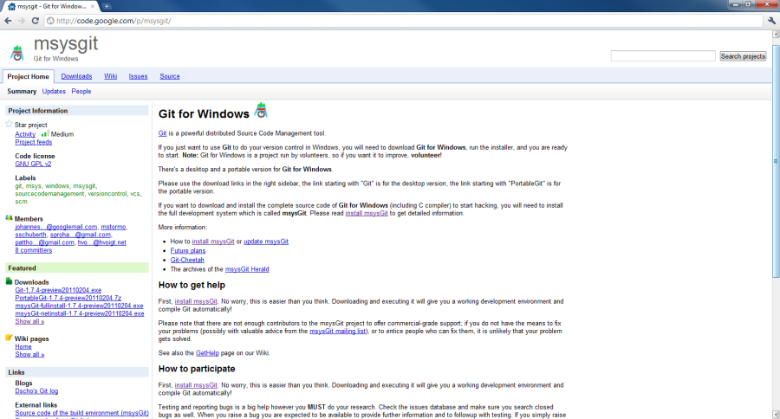
msysgit – Git for Windows
http://code.google.com/p/msysgit/

Slide 13
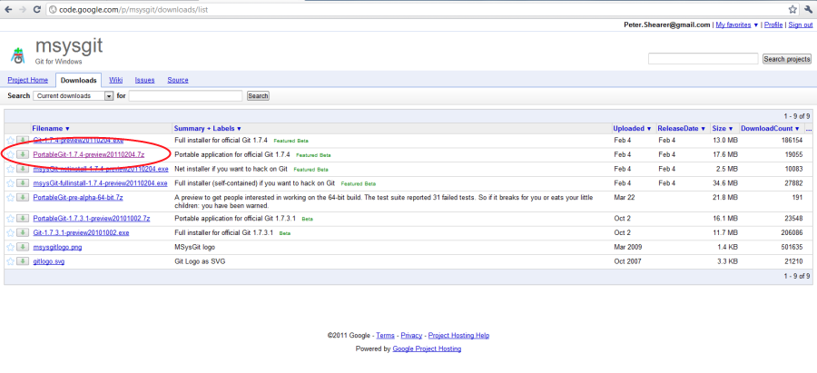
msysgit – Git for Windows
http://code.google.com/p/msysgit/downloads/list

Slide 14
Demo

Slide 15
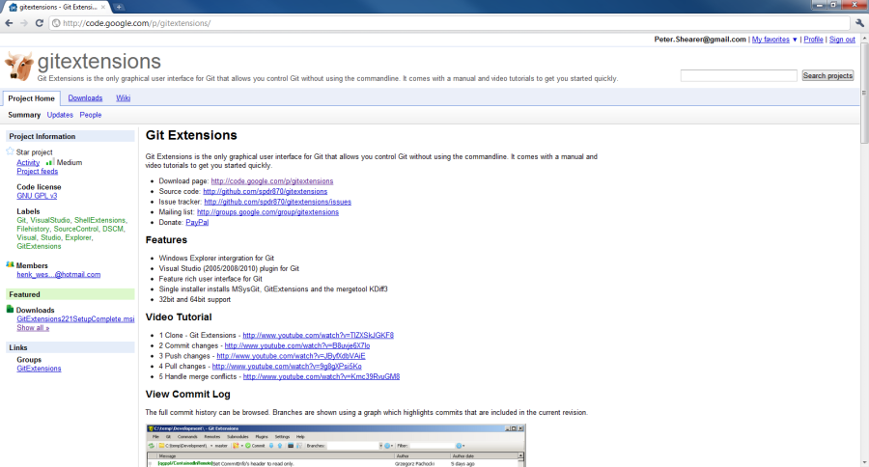
gitextensions
http://code.google.com/p/gitextensions/

Slide 16
Demo

Slide 17
Demo
.gitignore and .gitconfig

Slide 18
Demo
Powershell & Custom Startup Script

Slide 19
Git Commands
Init
Status
Add
Commit
Push
Branch
Checkout
Merge
Log
Reset

Slide 20
Demo

Slide 21
Demo
Git is Magic

Slide 22
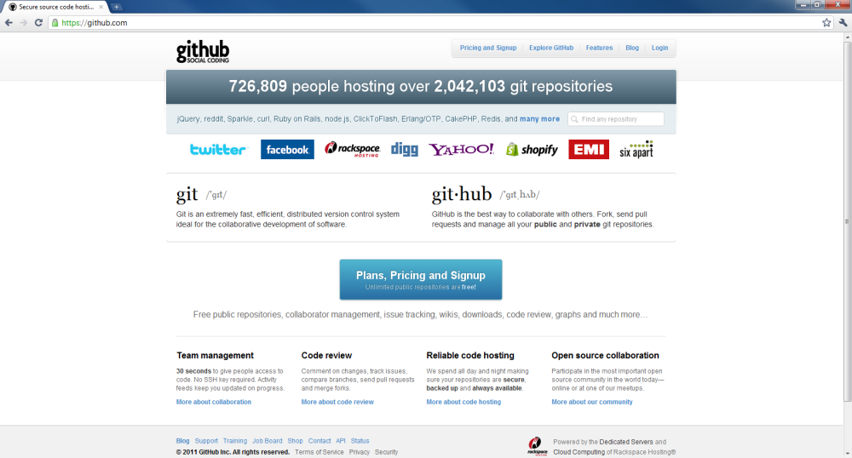
GitHub

Slide 23
Demo

Slide 24
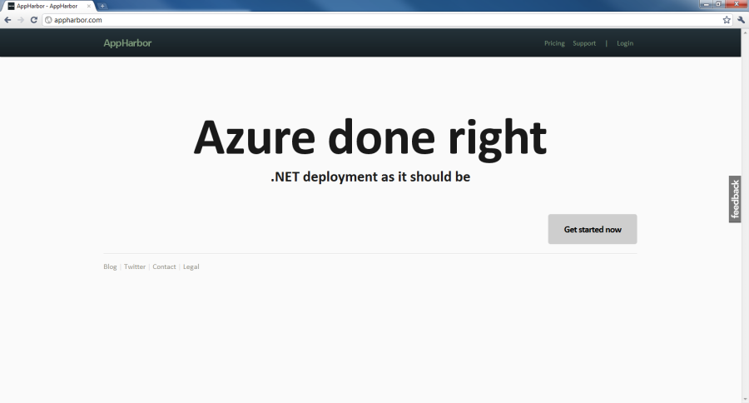
AppHarbor

Slide 25
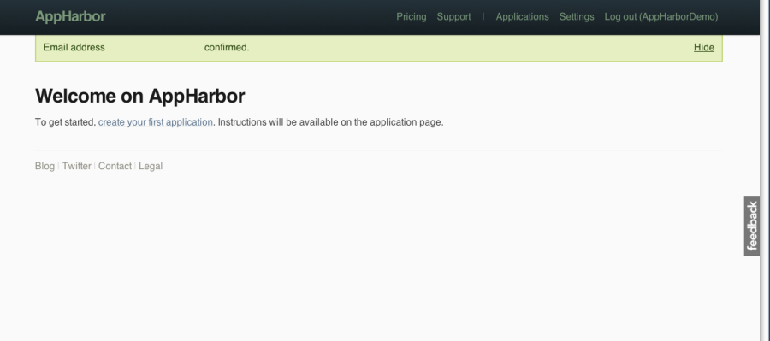
AppHarbor Setup

Slide 26
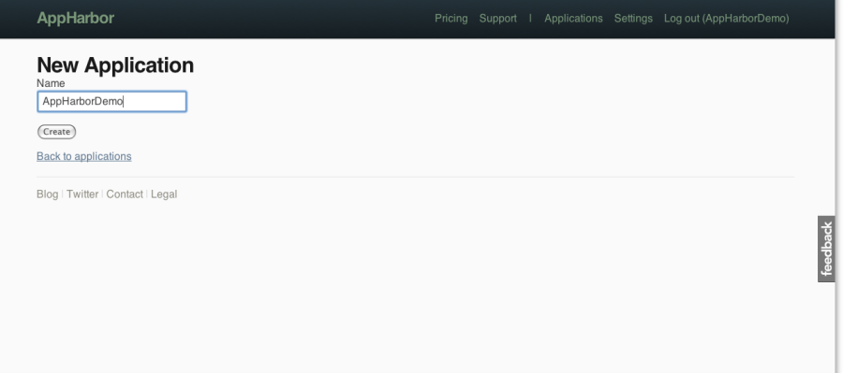
AppHarbor Setup (cont)

Slide 27
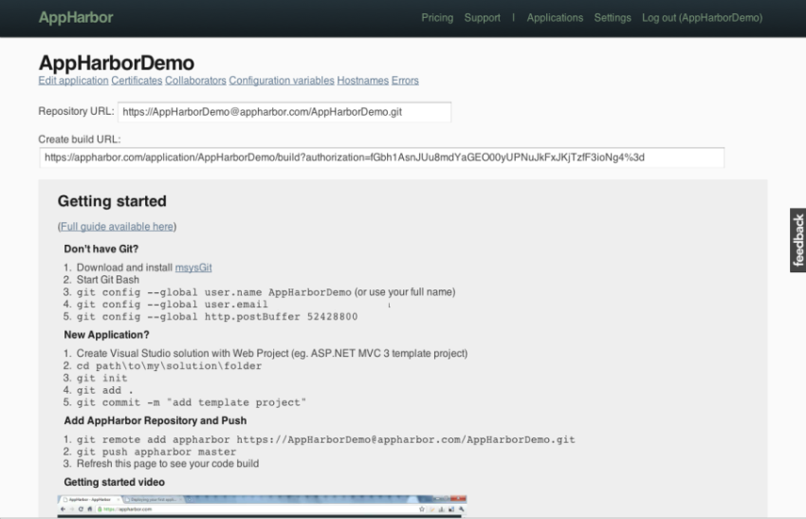
AppHarbor Setup (cont)

Slide 28
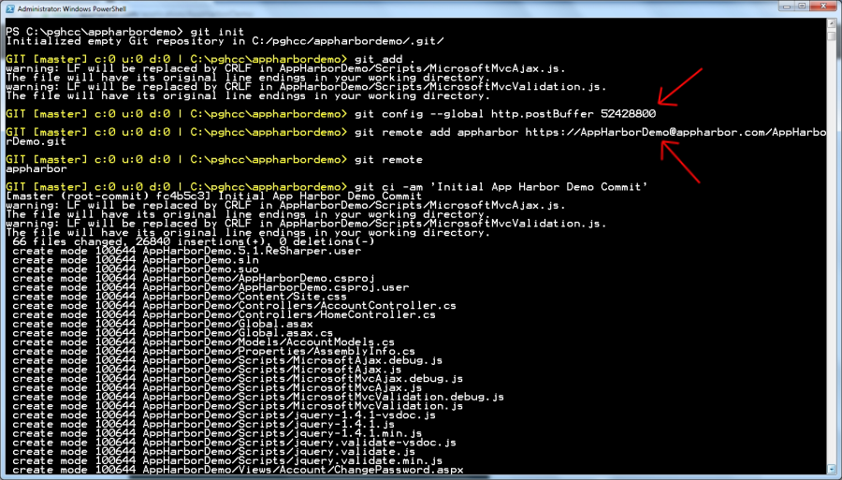
AppHarbor Setup (cont)

Slide 29
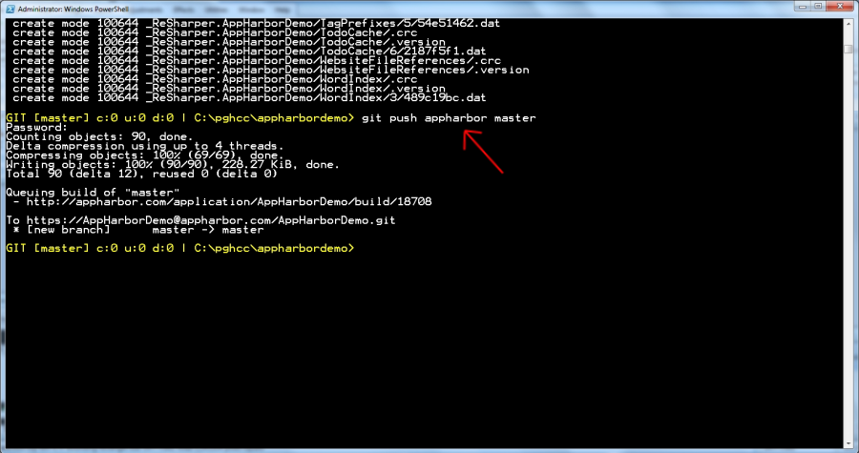
AppHarbor Setup (cont)

Slide 30
Demo

Slide 31
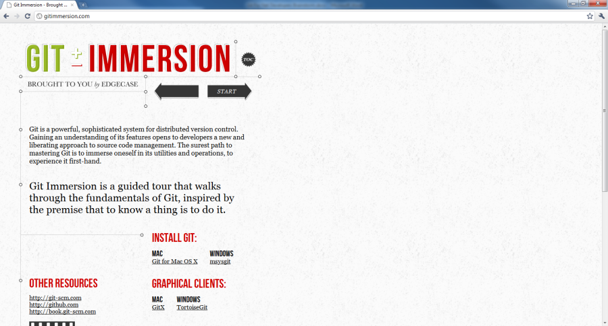
Git Immersion

Slide 32
Resources
Setting Up
http://help.github.com/win-set-up-git/
GitImmersion
http://gitimmersion.com/
Why Git is Better Than X
http://whygitisbetterthanx.com/
The Best Git Cheat Sheet Ever
http://www.ndpsoftware.com/git-cheatsheet.html

Slide 33
Q + A

Slide 34
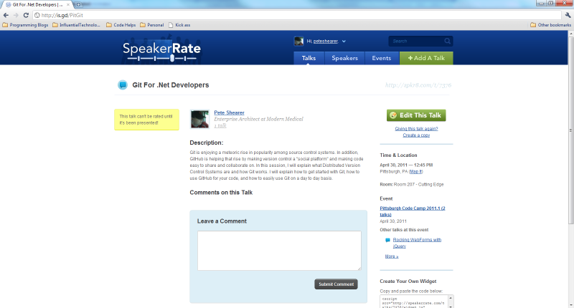
A Favor… Please?
http://is.gd/PitGit

